Slide 1

IoT-Enabled Neonatal Bilirubin Monitor & Automated Phototherapy System
A NON-INVASIVE APPROACH TO JAUNDICE CARE (PROTOTYPE)
Mayank Singh Harsh Sharma
TECH EXPO - 2K25

Slide 2

Problem
Neonatal Jaundice affects 60% of term babies and 80% of preterm babies.
1
Traditional detection requires frequent blood tests (heel pricks), causing pain and trauma.
2
Labs take time; high bilirubin can lead to brain damage (Kernicterus).
3
Parents/Nurses must manually check babies and turn on lights.
4
3

Slide 3



Solution
Replaces painful blood sampling (heel pricks) with painless, instant optical skin analysis using the TCS34725 Color Sensor
A smart control system that automatically activates blue phototherapy lights only when bilirubin levels exceed the safety threshold (Score > 10.0)
Enables doctors and parents to track ECG waveforms, SpO2 levels, and therapy status remotely via a live WiFi Web Dashboard
4

Slide 4
Roadmap
Phase 1
Phase 3
Hardware Assembly & Sensor Validation
IoT Dashboard & Cloud Connectivity
Phase 2
Phase 4
Firmware Logic & Algorithm Integration
Final Polish & Expo Presentation
10

Slide 5

System Architecture (Block Diagram)
Input Layer (Sensors) :
  TCS34725 (Skin Color/Bilirubin)
  MAX30105 (SpO2 & Heart Rate)
  AD8232 (ECG Signals)
  DHT11 (Room Temp/Humidity)
Processing Layer:
  ESP32 (Dual Core) running custom algorithms.
Output Layer:
  OLED Display (Local View)
  Solid State Relay (Therapy Lights)
  Web Dashboard (Remote View)
5

Slide 6
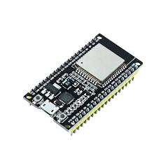
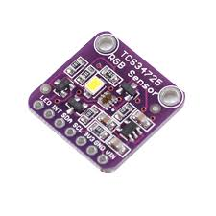
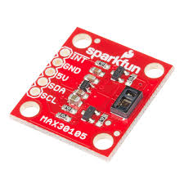
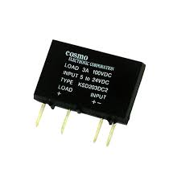
Key Hardware Components
ESP32 DevKit V1 (Dual-core, WiFi + Bluetooth)
TCS34725 RGB Sensor
MAX30105 (Pulse Oximetry)
6
Solid State Relay (SSR)

Slide 7
Technical Challenges & Solutions
Challenge
Solution Implemented
Sensor Conflict
Used Two Separate I2C Buses (Wire & Wire1) to handle multiple sensors (OLED, MAX30105, TCS34725) simultaneously without address crashes.
Real-time Graphing
Implemented a Circular Buffer algorithm to stream 200 data points/sec for smooth SVG ECG visualization.
Therapy Safety
Added a Threshold Logic (Score > 10.0) to prevent accidental UV exposure; system auto-shuts off when levels drop.
7

Slide 8
The Algorithm (Logic Flow)
  Data Acquisition: ESP32 polls TCS34725 color sensor every 50ms.
  Processing:
    Reads R, G, B values.
    Calculates Yellowness Index: (Red + Green) / Blue.
    Maps index to a Bilirubin Score (0-20).
  Decision Making:
    IF Score > 10.0: RELAY = HIGH (Therapy ON) & Alert Cloud.
    IF Score < 10.0: RELAY = LOW (Therapy OFF) & Log Normal.
8

Slide 9
Web Dashboard & IoT Features
Live Monitoring: View ECG, SpO2, and Temp from any phone/laptop on the WiFi network.
Visual Alert: The dashboard flashes RED when "Therapy Active."
Cloud Logging: Uses Google Apps Script to save data to Google Sheets for historical medical analysis.

Slide 10
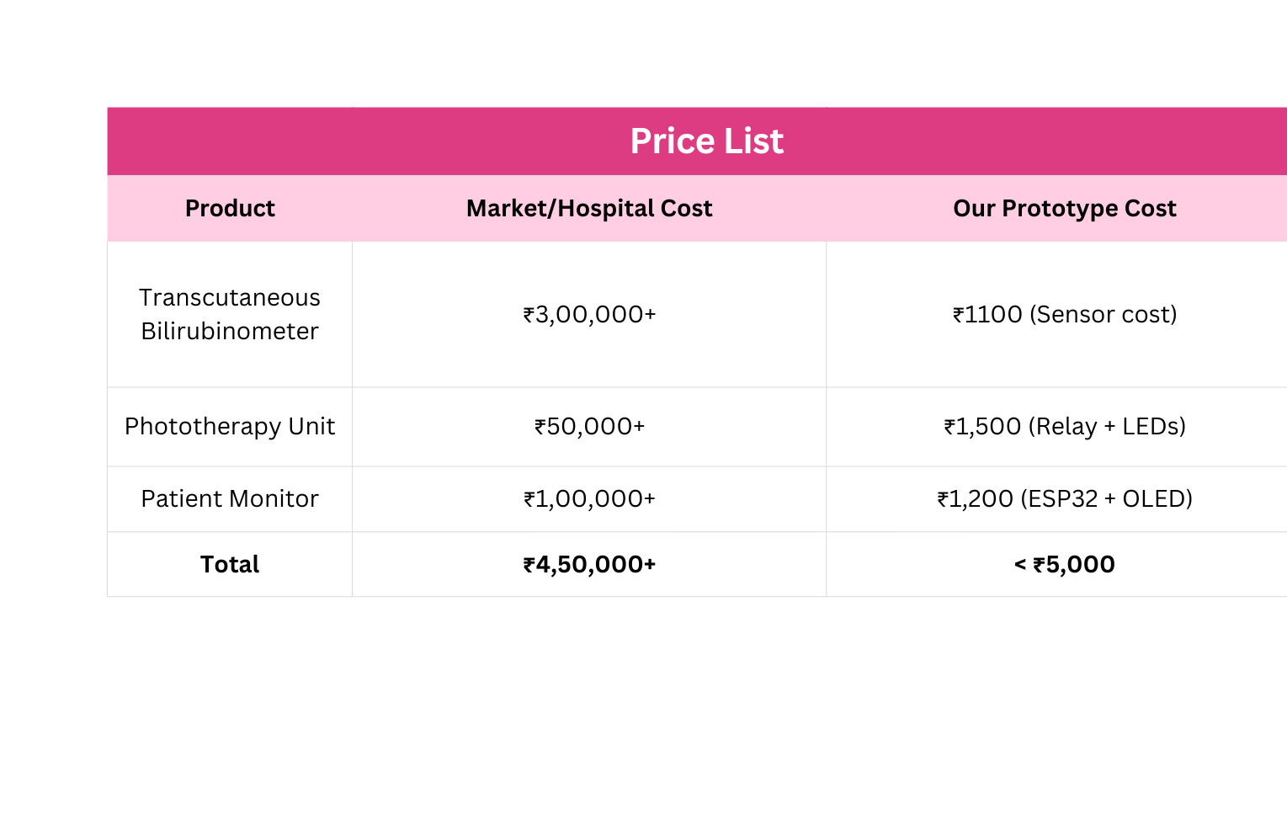
Cost Analysis (Prototype vs. Market)

Slide 11
Team
Harsh Sharma and Mayank Singh
9

Slide 12
Questions???

Slide 13
The End
THANK YOU

